Slide 1
Federalists and Anti-Federalists

Slide 2
Today’s Objective: Students will be able to identify the opposing sides in the fight for ratification and describe the major arguments for and against the Constitution.

Slide 3
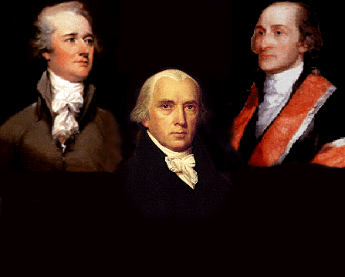
James Madison
Alexander Hamilton
John Jay
Publius
Federalists
Supporters of the Constitution

Slide 4
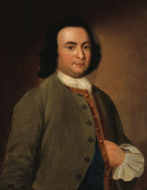
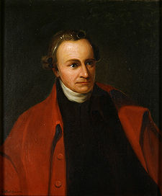
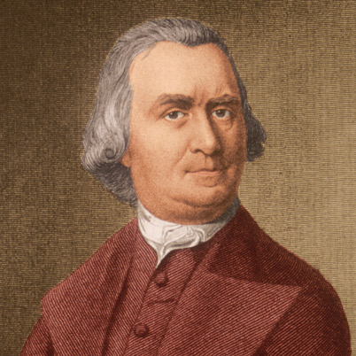
Patrick Henry
George Mason
Samuel Adams
Anti-Federalists
Opposed the Constitution

Slide 5
Federalists | Anti-Federalists
Supported the Constitution Strong National Government Did not see a need for a Bill of Rights Checks and Balances with bi-cameral legislature State legislatures, NOT the people had approved the Articles | Opposed the Constitution Weak national power Individuals were left out of the Constitution Supreme Court could overturn state courts Executive and Legislative too much power Military forces maintained by national government

Slide 6
Take a moment and reflect….
Do the Anti-Federalists care more about protecting individual rights or promoting the common good?
Do the Federalists care more about protecting individual rights or promoting the common good?

Slide 7
Individual Rights
The Anti-Federalists were more concerned with protecting the rights of the individual people and states, than promoting the public good as a whole.

Slide 8
Common Good
The Federalists were more concerned with promoting the common good of everyone than protecting individual rights

Slide 9
Test your knowledge!
Fill in the graphic organizer comparing and contrasting the Federalist and Anti-Federalist with what you took from the previous information.
Don’t look at the lecture!!!

Slide 10
Graphic Organizer
Federalists
Anti-Federalists

Slide 11
Quote Throw down!
You will be shown a quote and you must decide WHO SAID THIS?
The Anti-Federalists or the Federalists
You will work in groups, and write the answer on your white board
Do not show other groups.
You will reveal your answer on the count of three.

Slide 12
Quote #1
“All communities divide themselves into the few and the many. The first are the rich and well born; the other, the mass of people…. The people are turbulent and changing; they seldom judge or determine right. Give therefore the first class a ….permanent share in the government….they therefore will ever maintain good government.”
Who said it? _______________________

Slide 13
Quote #1
Who said it?
FEDERALISTS

Slide 14
Quote #2
“It must be by this time evident to all men…that (the Articles of Confederation) is a system so radically vicious and unsound as to admit….an entire change.”
Who said it? _______________________

Slide 15
Quote #2
Who said it?
FEDERALISTS

Slide 16
Quote #3
“Our country is too large to have all affairs directed by a single government.”
Who said it? _______________________

Slide 17
Quote #3
Who said it?
ANTI-FEDERALISTS

Slide 18
Quote #4
“The small landowners are the most precious part of the state.”
Who said it? _______________________

Slide 19
Quote #4
Who said it?
ANTI-FEDERALISTS

Slide 20
Quote #5
“I consider the foundation of the Constitution as laid on this ground – that all powers not delegate (given) to the United States by the Constitution, nor prohibited by it to the states, are reserved to the states, or to the people….”
Who said it? _______________________

Slide 21
Quote # 5
Who said it?
ANTI-FEDERALIST

Slide 22
Quote #6
“The powers contained in the constitution….ought to be construed liberally in advancement of the public good.”
Who said it? _______________________

Slide 23
Quote # 5
Who said it?
FEDERALISTS

Slide 24
Quote #6
“I am not among those who fear the people. They, not the rich, are our dependence for continued freedom.”
Who said it? _______________________

Slide 25
Quote #6
Who said it?
ANTI-FEDERALISTS

Slide 26
Quote #7
"I had rather be a free citizen of the small republic of Massachusetts, than an oppressed subject of the great American empire."
Who said it? _______________________

Slide 27
Quote #7
Who said it?
ANTI-FEDERALISTS

Slide 28
Quote #8
"I had rather be a free citizen of the small republic of Massachusetts, than an oppressed subject of the great American empire."
Who said it? _______________________

Slide 29
Quote # 8
Who Said it?
ANTI-FEDERALISTS

Slide 30
Quote #9
“Among the numerous advantages promised by a well-constructed Union, none deserves to be more accurately developed than its tendency to break and control the violence of faction.”
Who said it? _______________________

Slide 31
Quote #9
Who said it?
FEDERALISTS

Slide 32
Quote #10
“An elective [monarchy] was not the government we fought for; but one in which the powers of government should be so divided and balanced among the several bodies of magistracy as that no one could transcend their legal limits without being effectually checked and restrained by the others.”
Who said it? _______________________

Slide 33
Quote # 10
Who said it?
FEDERALISTS

Slide 34
Quote #11
“When the government fears the people, there is liberty. When the people fear the government, there is tyranny.
Who said it? _______________________

Slide 35
Quote #11
Who said it?
ANTI-FEDERALISTS

Slide 36
Quote #12
“… the power vested in congress of sending troops for suppressing insurrections will always enable them to stifle the first struggles of freedom."
Who said it? _______________________

Slide 37
Quote #12
Who said it?
ANTI-FEDERALISTS

