Slide 1
US History Unit 1: Colonization
Coach Aiello

Slide 2
Monday (8/7) Essential Question
Why did countries want to establish colonies? What were the reasons behind the founding of the Virginia Colony?

Slide 3
Us history Standard
SSUSH1 – Compare and Contrast the development of English settlement and colonization during the 17th century.
A. Investigate how mercantilism and trans-Atlantic trade led to the development of colonies.

Slide 4
Important vocabulary and terms
Mercantilism
Navigation Acts
Triangular Trade
Indentured servants

Slide 5
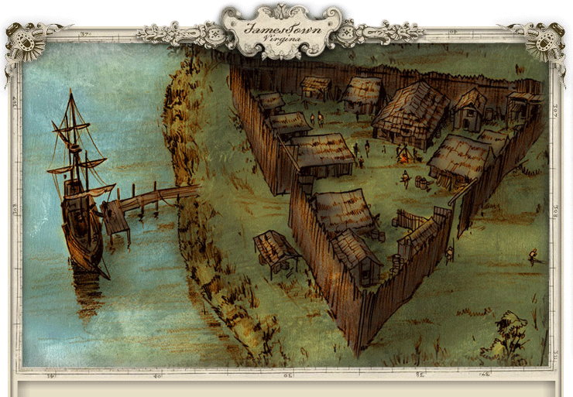
Early colonization
Although many English colonist came to the New World in search of religious tolerance and acceptance, it was economic opportunity that fueled the ambition of other English colonists as well as ENGLAND itself.
England was seeking the potential natural resources from the New World that would allow them to compete both economically and imperially with rival European nations.

Slide 6
Mercantilism
Definition
Visual
Economic theory based on reducing a country’s imports while expanding its exports in order to maximize wealth.
During this time in Europe, WEALTH=POWER
Mercantilism inspired European governments, including England, to promote American colonies as sources of raw materials not readily available in the mother country.

Slide 7
mercantilism
Resources taken from colonies and given to England:
Lumber
Sugar
Wool
Tobacco
Rice
Indigo
These raw materials were then used in England to produce manufactured goods for export to other European countries and back to the colonists in North America.

Slide 8
mercantilism
A favorable trade balance resulted for England in the colonial arrangement.
Raw materials that were scarce in England were acquired from their colonial possessions.
Simultaneously, the colonies were a ready market for the manufactured products produced in England from the raw materials.
The trans-Atlantic trade network that resulted led to various colonial labor arrangements and restrictive policies to ensure England maximized its mercantilist potential

Slide 9
Navigation acts of 1663
Laws that regulated trade between England and its colonies
The laws were designed to keep England’s own colonies from competing with their mother country by mandating three fundamental criteria for trans-Atlantic trade.
Rules:
All goods shipped to or from English North America had to travel on English ships
Any goods being imported to the colonies from Europe had to first be processed through an English port.
Most colonial resources could only be exported to England

Slide 10
Navigation Acts of 1663
The Navigation Acts restricted:
the profits colonists could receive for their products
hindered the development of large scale manufacturing in the colonies
forced colonists to pay high prices for goods they were only allowed to purchase from England
Positives that came out of Navigation Act?
Emergence of ship building as a new industry in the colonial states
Instant demand for lumber
Negatives that came out of Navigation Act?
Increased smuggling

Slide 11
Triangular Trade (trans-atlantic)
England’s trans-Atlantic trade flourished under the mercantilist system.
Took a three step voyage around the Atlantic rim:
First, English ships loaded with rum, cloth, and other manufactured goods sailed to Africa, where they were traded for Africans as part of the slave trade
Then, in the Middle Passage (discussed further in SSUSH2), the slaves were transported on a brutal voyage to the Americas and sold there as a forced labor commodity to colonial landowners.
Third step of the journey transported American raw materials to England to be made into the manufactured goods that would start the cycle again.

Slide 12
Triangular trade

Slide 13
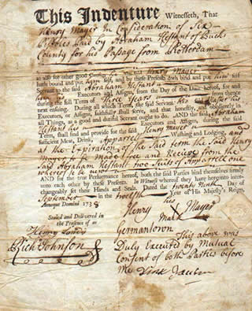
Indentured Servants
Colonial labor was critical for the production of materials England needed for a profitable mercantilist system.
Labor needs were first filled through the use of indentured servants and then later by permanently enslaved Africans
Definition:
Indentured servants were typically lower class Englishmen who could not afford to pay for the voyage to North America but saw life in the colonies as an opportunity for economic advancement they would otherwise never have in England

Slide 14
Indentured servants
Indentured servants worked for a land owner in exchange for their passage to North America.
The land owner obtained labor and the indentured servant obtained the future opportunity to own land after working off their debt over a period of approximately four to seven years

Slide 15
conclusion
England developed resource-producing colonies in North America primarily to:
Fuel mercantilism and to amass wealth and power over their European rivals.
The resulting trans-Atlantic trade system was regulated through Navigation Acts and led to various labor sources being used by colonists to meet the resource demands of England.
Go back to the EQ?
-Why did countries want to establish colonies? What were the reasons behind the founding of the Virginia Colony?

Slide 16
Key vocabulary review
SSUSH1 – Compare and Contrast the development of English settlement and colonization during the 17th century.
A. Investigate how mercantilism and trans-Atlantic trade led to the development of colonies.
Vocabulary:
Mercantilism
Navigation Acts
Triangular Trade
Indentured servants

Slide 17
Story of us..
http://www.dailymotion.com/video/x2aqkyk

Slide 18
Tuesday (8/8)
Essential Question:
What was life like in the early Jamestown Settlement?

Slide 19
Southern Colonies
SSUSH1 – Compare and Contrast the development of English settlement and colonization during the 17th century.
B. Explain the development of the Southern Colonies, including but not limited to reasons established, impact of location and place, relations with American Indians, and economic development

